Slide 1
Universal Sampling Guidelines and Selection for Applied Genomic Epidemiology
Notes:
This lecture will cover universal sampling guidelines, which will have implications for the types of questions you can answer. No hard and fast answers here and so this presentation will cover the things we want to think about for sampling, the questions, and the assumptions our models make. Across the literature many of them are convenience samples and you have to be pragmatic about it.

Slide 2
When designing epidemiological studies we often ask…
How large should the study be?
  Type I/II error rates, effect sizes, power.
How should we design the study?
  Case definition, control selection, what to measure, confounding
Notes:
Number 2 is arguably harder, and where most of the “art” is in this.
Overlap between traditional epi and genomic epi. When we are designing a study, we have to think about sample size and the size of the study for type 1 and type 2 error rates, effect size to detect a clinically relevant difference between populations (if there is one), and how do we design for case definitions, how to select controls, what you decide to measure, and what confounders could exist. We have formulas for number 1, but study design is more of an art of who should be in a study and what we need to measure about them.

Slide 3
We should ask the same questions for genomic epidemiological studies.
How large should the study be?
  Depends on the question, best answered by simulation-based inference.
How should we design the study?
  Case definitions, control groups, confounding
Notes:
Number 2 is arguably harder, and where most of the “art” is in this.
Monet’s formula for what # of people you need to detect X. You could simulate sampling scenarios to see dynamics in a real dataset. Right now, that is what people do. But, we are going to focus on part 2 of how to design the study, who we want to include, and cover a variety of epi questions.

Slide 4
It’s important to think about sampling strategies for different genomic epidemiological questions/studies.
Monitoring for lineage frequency changes.
Phylogeographic studies to explore descriptive epidemiology.
Outbreak investigations/exploring fine scale transmission dynamics.
Notes:
Cover different detections like emerging or sweeping to fixation of different lineages; phylogenetic studies for descriptive epidemiology, analytic epi studies that use genomic information. Answering outbreak investigations and exploring fine scale transmission dynamics in limited settings.

Slide 5
A theoretical population in which people mix homogeneously, such that any two individuals have equal probability of coming into contact and infecting one another.
Notes:
But before we get into those specifics, I want to start out talking about populations.
Here we have a homogenously mixed population. Each dot has equal probability of mixing with any other blue dot. Coming into contact with others has equal probability.

Slide 6
Given equivalently fit viral lineages, you would expect all lineages to circulate broadly across the entire population.
Notes:
In this kind of population, you would any lineage
Equally fit viral lineages, they distribute across the entire population equally. Yellow strain can go on to infect anyone else, and same for the red one. To get a picture of the lineages circulation, all you have to do is randomly sample this population.

Slide 7
In reality, people mix heterogeneously. Rather, we have structured populations. This affects pathogen circulation too.
Notes:
In this kind of population, you would any lineage
But, that’s not the reality. People interact with others based on where they live, work, languages, age, etc. in reality, because people don’t have equal probabilities of coming into contact with each other, when they are infected lineages don’t spread uniformly across a population. Different people may have different probabilities of coming into contact with certain lineages. We have to account for this.

Slide 8
The variables that structure populations can thus modify the probability of being exposed to particular lineages.
Notes:
And this is important to recognize across a whole host of studies that you aim to do!
It varies depend on which bin or population you live in.

Slide 9
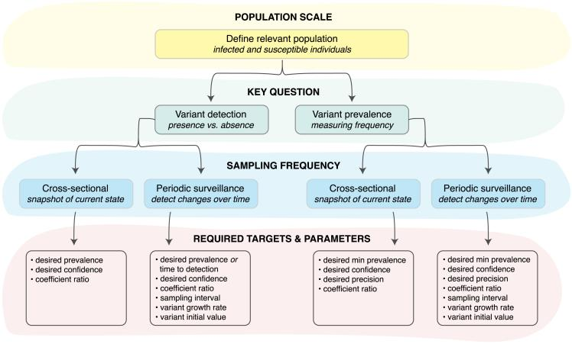
Designing a sequencing-based study or surveillance system
Wohl et al., 2023

Slide 10
Part 1 - Sampling design for monitoring changes in lineage frequency.

Slide 11
To be able to monitor changes in lineage frequency, you want your dataset of sequences to be representative of the true underlying viral population.
In a homogenous population, sample infections at random to get random sampling of viral diversity.
Notes:
Homogenous population mixing. To do this study, you sample this population so that the sequences in your dataset are representative of those underlying the population of infected individuals. We don’t sequence every case at the country level. So to what extent does our dataset represent the viral diversity represented in the population? If you sample at random, what is the probability that it represents the underlying population?

Slide 12
To be able to monitor changes in lineage frequency, you want your dataset of sequences to be representative of the true underlying viral population.
In a structured population, you need to make sure you’re not missing pockets of infections/viral diversity.
Notes:
So, we need to know what’s actually happening at the underlying population… we have a structured population. We want the viral diversity of what is in our population. If we don’t account for how people get exposed to these lineages we aren’t going to see the viral diversity out there. Determine the factors that impact people’s probability to move across groups and sample from all the bins. You would sample those different bins in proportion to the incidence within those bins. If you really want a representative dataset, randomly selection may overselect with certain biases. You may enrich for certain lineages and remove other compared to what is actually circulating in a population.
Issues in the US around s-gene target failure and sequencing– artificially biases your dataset for one particular genotype. Might be helpful to answer if B117 is here, but you have altered your dataset to be hard to see the change in frequency because you’ve enriched a dataset to detect a lineage at baseline and screened out other lineages that don’t have this. This was right after a big surge, that we missed other potential lineages because we had altered things. Knowing why samples were sequenced is important to be filtered out of baseline surveillance to not artificially enrich baseline.

Slide 13
In this case, “how much should you sequence?” is typically related to what lineage frequency you want to be able to detect.
Notes:
When I’ve seen this question explored, it is typically for the theoretical homogenously mixing population on the left. You could totally do fancy things to model the scenario on the right, but that would be more effort, which you can totally do, but sometimes the faster thing is just to think about what those bins are and try and get representation across them.
How much you sequence depends on the frequency you want to detect (10% vs 30%)? What frequency level matters? Run a few models for either scenario. Sequence groups with transmission within than between and randomly sample in those bins where it is in proportion to the amount that is happening. You can target for specific phenotypes but it can’t be your baseline surveillance testing. Targeted happens on top of this. Cant detect outbreak if you don’t know what normal is.
No formal way to specify what level of intensity to sequence at and no set ways of how a population is set up (i.e. geography, age, etc. requires you to think about the factors that impact how people move. This could vary by region or country. Ex. my jurisdiction north and south county. What divides your population to transmit within themselves. Historically, we didn’t really have to ask these questions because there just wasn’t this much data. But, we do now, because of COVID and now that there is so much genomic surveillance undergoing. If we have lower prevalence, we may have different questions and less concerned about ex emerging lineages approaching fixation.

Slide 14
Part 2 - Sampling design for phylogeographic studies.

Slide 15
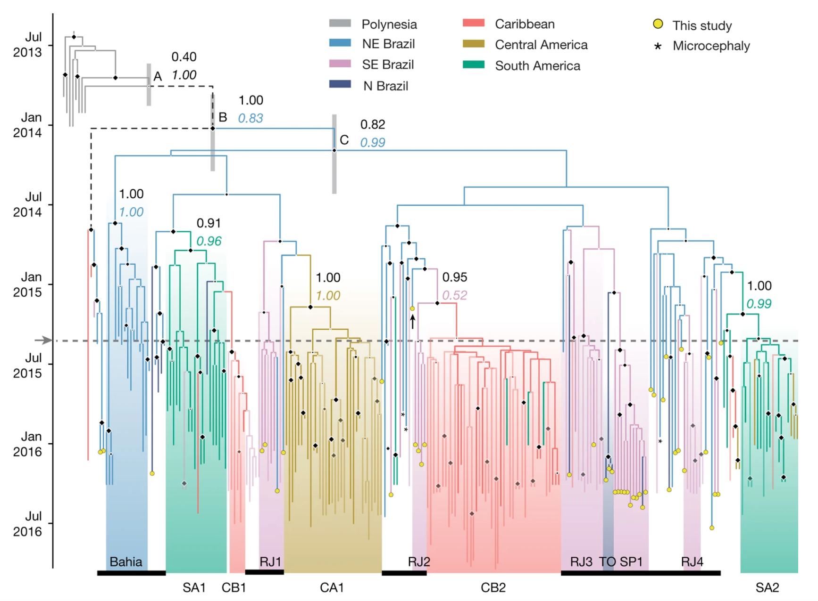
“Phylogeographic” studies describe spatial distribution patterns of a pathogen across a phylogeny.
Faria et al, 2017
Notes:
Genome sequences along with where, regionally, they were collected. You refer the ancestral state for the node sin the tree. How we model the spatial trait or sequence evolution across the tree. This model is fast and user friendly. Is used in Nextstrain, with a fundamental assumption that is violatable: assumes samples are collected at random at a population. The # of sample represented is related to the outbreak size of those regions.

Slide 16
Discrete trait reconstruction assumes that samples are collected at random from the population.
This means that model treats the number of samples from a particular location as information about the pathogen population size in that location.
Notes:
Pragmatically, this can be hard to do, and so often the get around is to (like the phylodynamic model), sample different geographic locations uniformly. This assumption is often violated, which is why we frequently do sensitivity analyses around sampling intensity with phylogeographic reconstructions like this.

Slide 17
Ideally, you would sample from different geographic areas proportionally to incidence in those areas.
Size of outbreak
N genomes in tree
20
5
Notes:
Pragmatically, this can be hard to do, and so often the get around is to (like the phylodynamic model), sample different geographic locations uniformly. This assumption is often violated, which is why we frequently do sensitivity analyses around sampling intensity with phylogeographic reconstructions like this.
The orange outbreak is 4x the size of the blue outbreak. If we didn’t look at where people were coming from, sample 20 from orange and 5 from blue country. DTA model treats this number as information that propogates through the tree.

Slide 18
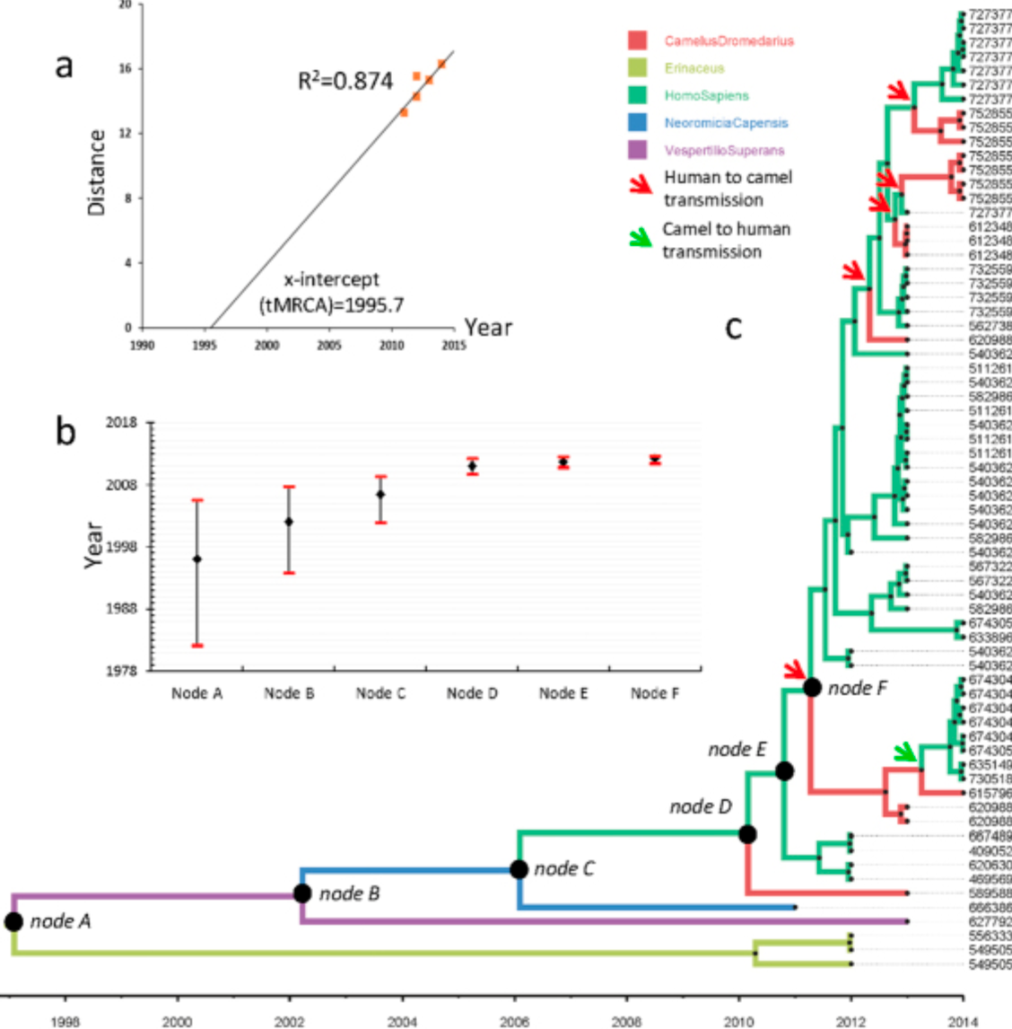
One of the clearest examples of this is “human-to-camel” MERS transmission (Zhang et al, 2016).
Notes:
The trait we are inferring here is HOST instead of geography! Doesn’t matter, the procedure is the same.
Replace geographic trait for host trait. Ex. mers, where virus circulating in humans that camels. When you run this model, it treats those counts as information where this model describes mers primarily circulating in humans and spilling over to camels. Not true! More complex models for geographic and migration patterns that are accurate without using sequence counts as information.

Slide 19
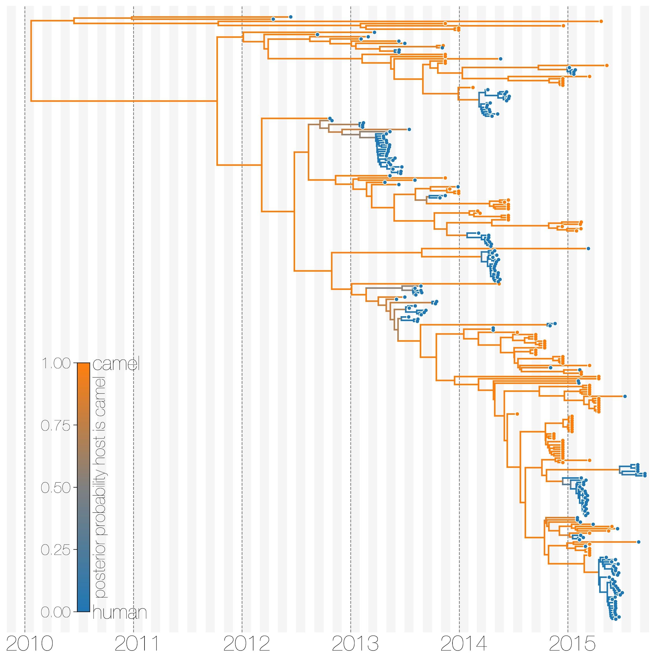
Using a more complex model that handles sampling bias produces the accurate reconstruction showing camel-to-human spillover events (Dudas et al, 2018).
Notes:
You can correct for these issues with more specialized evolutionary models that we can totally talk about at a later date if people are interested!
This has been corrected. If you don’t want to use fancy models, you have to sequence or sample from groups in proportion to the outbreak size within those groups to prevent bias.

Slide 20
Ideally, sample from different groups proportionally to incidence in those groups.
Notes:
You may not know the incidence in a particular area, so pragmatically you may want to sample uniformly from the different bins. Usually if you sample from each bin then the structure in the tree won’t be from disproportionate sampling. Uniform sampling or down sampling so that a tree with equal representation for primary sensitive analysis to look at sampling changing patterns on the tree. Uniformly works well across the different bins.

Slide 21
Part 3 - Sampling design for outbreak investigations.

Slide 22

SEQUENCE
Notes:
And my intuition for this is just that it’s your best bet to really see linkage between cases, directionality within the outbreak, emergence of anything strange etc. You might not have enough diversity accrue over the outbreak to resolve everything, but in a localized setting there’s potentially a lot to learn by sequencing all the cases.
The major thing I want to stress though is that a “baseline” dataset does NOT get constructed then by in depth sequencing of multiple localized outbreaks! You have divergent sampling regimes, and you actually want both...ESPECIALLY if you want to contextualize where an outbreak came from and what happened afterward (e.g. spillover back into the community?) So typically you will want to try and support BOTH sampling strategies.

Slide 23
Take home messages!

Slide 24
For most studies, aim to capture a picture of the full circulating viral diversity by recognizing how your population is structured, and sampling from all the “bins”.
Notes:
Uniformly is okay.
Two datasets are needed: targeted and baseline.

Slide 25
Metadata collection and integration for applied genomic epidemiology
Paul Oluniyi, PhD
Scientist, Chan Zuckerberg Biohub

Slide 26
While sequence data are a critical component of genomic epidemiology, additional information about the sample (or infected individual) allow richer analysis.
Genomic data
Metadata
A3487G
A
A, 02-11-2021, Summerland, F, 32
T8897C
B, 01-31-2021, Peachland, M, 68
B
A45G
C, 02-08-2021, Kelowna, F, 44
A101G
T1089A
C
D, 01-10-2021, Penticton, F, 32
D
C1321T
E, 01-09-2021, Penticton, F, 33
E
A2355G, T4567C, G5982A, T5998C, C9563T
F
F, 02-11-2021, Moosejaw, M, 76

Slide 27
Some of many ways data can go awry… inconsistency makes data harder to interpret and more difficult to integrate.
Sample
Nasal swab
Diagnostic specimen
Date
2/1/21
2021-03-03
Host
Human
Wastewater
Notes:
Data organization and consistency is important both so that YOU can come back to the data in the future (and keep private data well organized and linked to samples), and it’s also important for facilitating data sharing in you need or want to share data across jurisdictions. Variability in data structures (how we encode all of the associated data about a sample) can make it really difficult to know apples from oranges, and make sure you’re comparing apples to oranges. It makes data HARDER TO INTERPRET (because you don’t know what’s what exactly), and DIFFICULT TO USE (especially if you’re trying to do things like run automated scripts). Different data structures make data less interoperable and HARDER to INTEGRATE

Slide 28
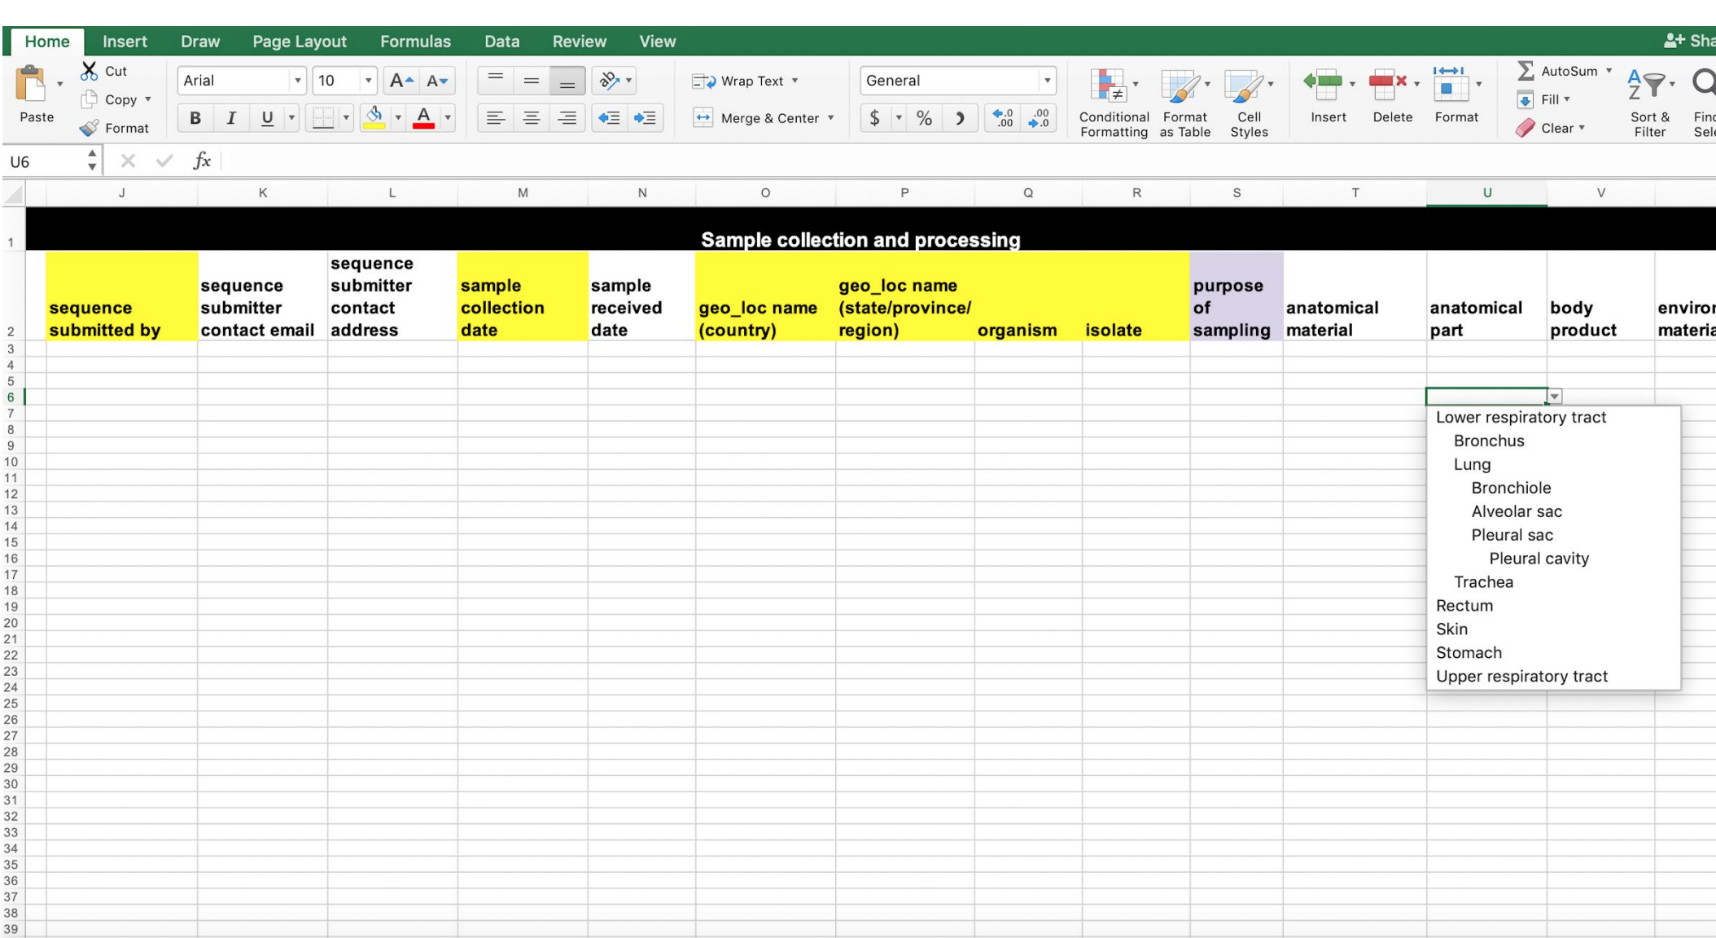
A data specification to improve data consistency!
Notes:
Solution == having a consistent way to specify data fields and track them that many people also use!
Data Spec is a spreadsheet that is a STANDARDIZED DATA COLLECTION TEMPLATE: It specifies important fields you should track (mandatory), recommended fields, but then also has organization and structure for many additional fields that you don’t have to use but might find useful. There are also pick lists in the template that allow you to choose standardized terms to fill in the data, so that actual entries are consistent across records. There are also structured formats for fields such as dates that ensures that all dates are formatted in the same standard, which is pretty critical especially for international data sharing.

Slide 29
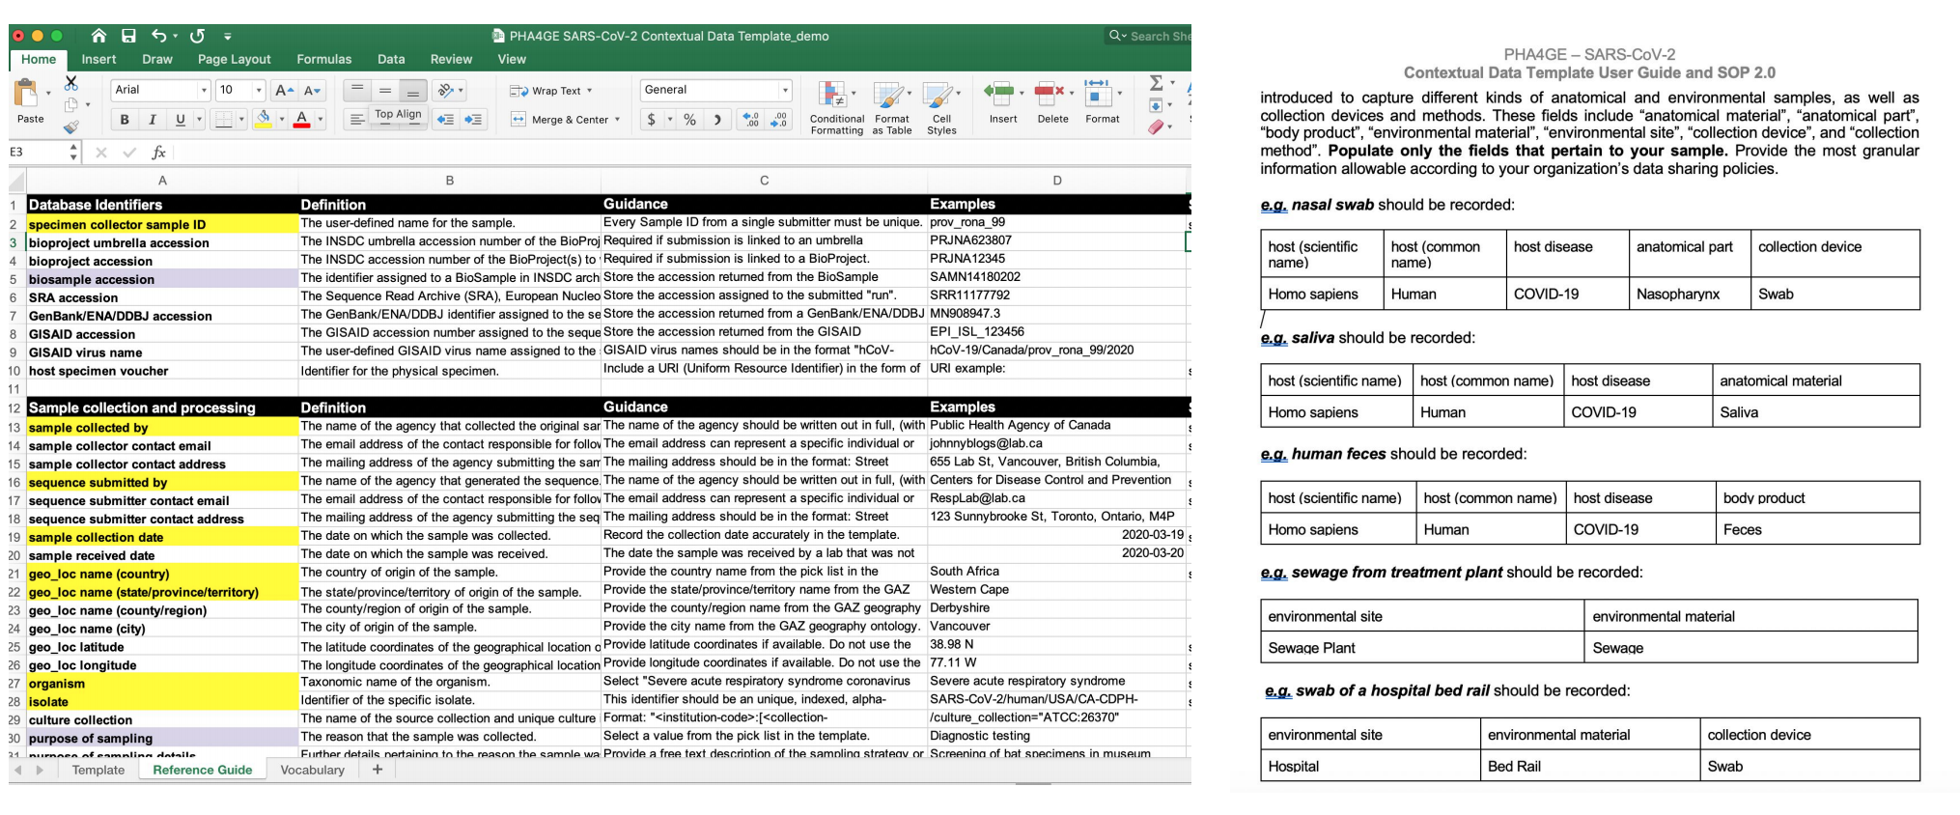

Slide 30
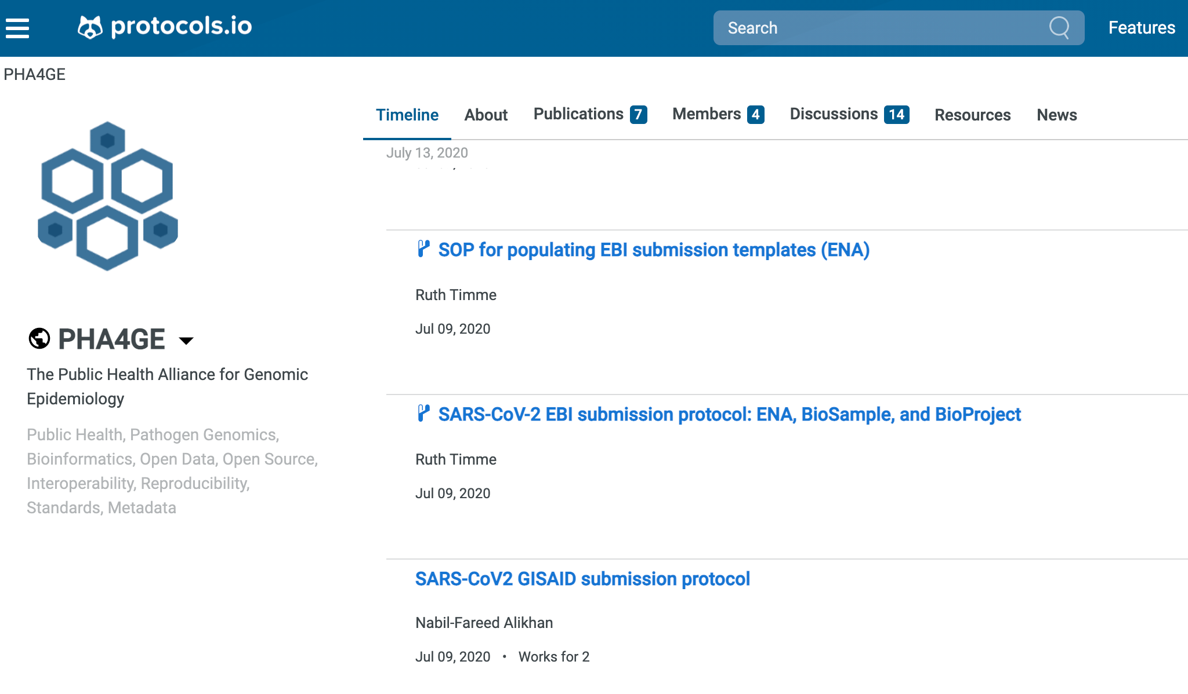
https://www.protocols.io/workspaces/pha4ge

Slide 31
Questions?

